Slide 1
1.Introduction
This is a historical Uber ride data to identify key patterns in fare prices and ride frequency.
This project explores the Uber Fares dataset to uncover patterns in pricing, ride frequency, and operational trends. Using Power BI and Python for data processing and visualization, the goal is to deliver actionable insights that inform business strategy and improve rider experiences.
Tools Used:
Python: for data loading,cleaning,feature engineering
Power BI:for building interactive dashboards and visualizations
Project Objectives:
Understand fare behavior by hour,day and month
Visualize pickup locations and ride density in NYC
Identify peak demand periods for optimization insights

Slide 2
2.Dataset Overview
Contains 200,000 ride records.
Key Columns:
pickup_datetime: timestamp of ride start
fare_amount: price of the trip
pickup_longitude & pickup_latitude
dropoff_longitude & dropoff_latitude
passenger_count
New Columns Created in Python:
hour (from pickup time)
day_of_week (e.g., Monday)
month (1–12)
peak_status (categorized as 'Peak' or 'Off-Peak')

Slide 3
3.Data Cleaning Methodology
Before diving into analysis, the dataset underwent rigorous cleaning using Python (Pandas). The steps included:
Missing Data Handling
Identified missing values in key fields such as fare_amount, pickup_datetime, and location coordinates.
Removed rows with missing or zero fare values.
Dropped entries missing latitude or longitude for pickup and drop-off points.
Data Type Corrections
Converted pickup_datetime from string to datetime format.
Ensured numerical columns (e.g. fare_amount, trip_distance) were properly
Outlier Detection and Filtering
Removed extreme fare values (e.g. over $1000) not representative of typical trips.
Filtered unrealistic coordinates falling outside city limits or geographic bounds.
4. Duplicate Removal
Dropped duplicate records based on timestamp, pickup location, and fare.
5. Enhancement for Analysis
Extracted hour, day, month, and day of week from timestamp.
Added peak/off-peak indicators based on commuting windows (e.g., 7–9 AM, 5–7 PM).
Exported cleaned and enriched data to CSV for Power BI visualization.

Slide 4
4.Analysis
1. Descriptive Insights
Average fare amount: $12.43
Range: $2.50 to $75.00
Most frequent fare bracket: $10–$15
2. Time-Based Patterns
Busiest Hours: 7–9 AM and 5–7 PM
Peak Days: Thursdays and Fridays
Seasonal Trends: Higher ride frequency during summer months
3. Geographic Distribution
New York City saw the densest cluster of ride pickups
Fares tended to be higher in Manhattan during evening hours
4. Correlations
Strong positive correlation between distance and fare
Mild influence of time of day on pricing

Slide 5
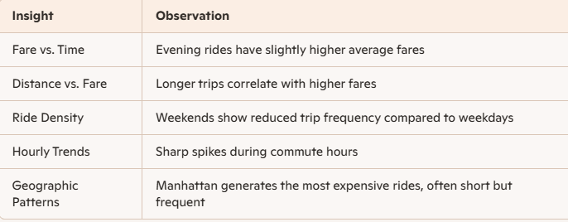
5. Results & Key Insights

Slide 6
6. Recommendations
Dynamic Pricing: Adjust pricing during peak commute hours to optimize revenue and rider flow
Target Promotions: Offer off-peak ride discounts to stimulate demand
Geo-Based Strategy: Expand driver coverage in low-frequency zones during busy periods
Dashboard Utility: Monitor operational metrics live for adaptive decision-making
7.Conclusion
The Uber Fares dataset reveals meaningful insights into how pricing and ride patterns shift based on time and location. By leveraging feature engineering and visualization, Power BI empowers users to tell a clear data story. The dashboard serves as an essential tool for both real-time monitoring and strategic planning.

